Slide 1
No Gain without pain
teething troubles in STATS19 data AS CRASH develops

Slide 2
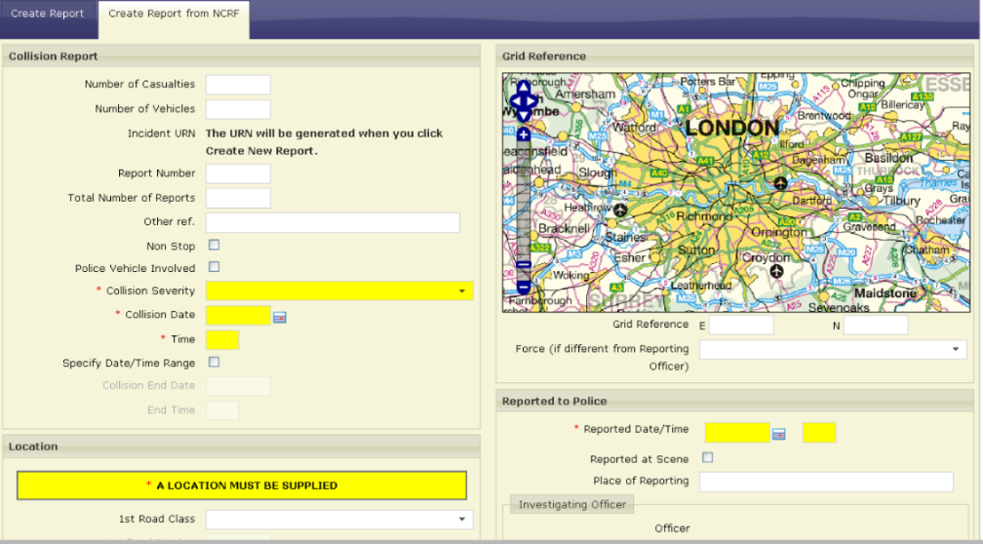
What is CRASH?
Collision Reporting And SHaring
  Online/mobile tool for collecting, storing and sharing data
  includes non-statistical data
Central service now maintained by DfT
Standardised collection, storage and validation
Available free of charge
Some forces choose own systems
Consequences of new methods
  More consistency, and
  More inconsistency …

Slide 3
Crash Adoption – early stage
Piloted by Surrey Police since 2012
Seven more forces phased in during 2015
  Devon and Cornwall
  Essex
  Gloucestershire
  Staffordshire
  Warwickshire
  West Mercia
  West Midlands

Slide 4
Crash Adoption – Later stage
Eleven more forces phased in during 2016
  Bedfordshire
  Cambridgeshire
  Cumbria
  Durham
  Hertfordshire
  Humberside
  Kent
  Norfolk
  Northumbria
  South Yorkshire
  Suffolk
All nineteen forces continue CRASH through 2017 onwards

Slide 5
Consequences of change
AIS-Code | Injury | Example
1 | Minor | superficial laceration
2 | Moderate | fractured sternum
3 | Serious | open fracture of humerus
4 | Severe | perforated trachea
5 | Critical | ruptured liver with tissue loss
6 | Maximum | total severance of aorta
Collection inevitably affects data
  Consequences not always foreseen
Example: better Severity recording
  Killed-Serious-Slight model flawed
  Maximum Abbreviated Injury Scale
Two key outcomes
  Data quality improvement
  Data consistency challenge
DfT and ONS research
  Solution for practitioners

Slide 6
Serious Injury
Serious injuries recorded 5% more often in CRASH forces
What matters most: statistical significance or practical purpose?
+522 p.a.
+503 p.a.

Slide 7
Hit and Run
Over a thousand fewer hit and run vehicles in 2016-17

Slide 8
Officer attended Scene
May reflect real differences in practice

Slide 9
Pedestrian Casualty location
Possibly related to officers attending less frequently

Slide 10
Ages
Encouraging reduction in unknown ages
More children and senior citizens

Slide 11
Sex
Encouraging reduction in unknown sex
Increase in rate of reporting females

Slide 12
Junction Detail
Far more reporting of ‘no junction’
Roundabouts up
Private junctions down most

Slide 13
Speed Limit
Reduction in 30 reporting
May reflect less reliance on default
40, 50 and 70 all up
20 reported far less frequently

Slide 14
Road Class
Fewer collisions reported as A or B
More collisions reported on Motorways and minor roads

Slide 15
Vehicle Lane Location
Encouraging reduction in unknown
Increase in recording of vehicles on footway

Slide 16
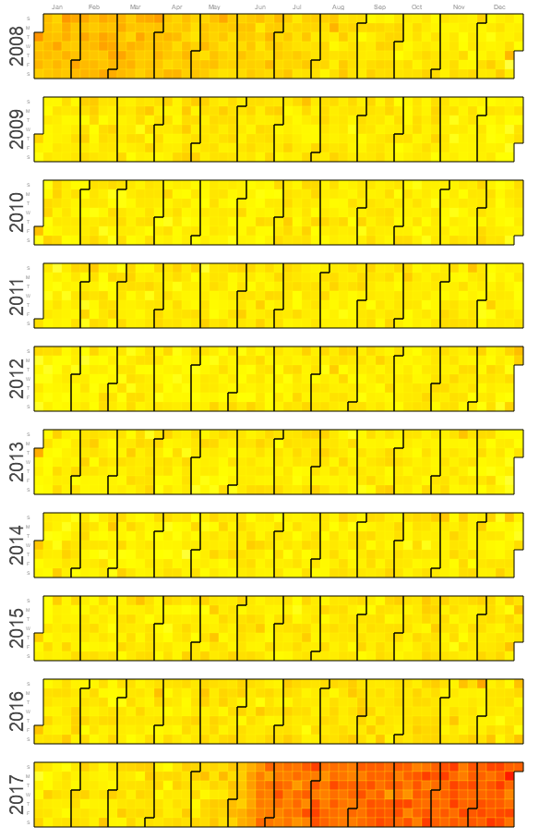
Postcodes in 2017
Dramatic reduction in recording
  Calendar shows GB reporting for all forces
Issue in CRASH V6 identified
  Address Search feature problem where multipart PENTIP address format not used
  Extent of problem varies depending on local practice
Postcode data critical for many uses
  No irrevocable data loss occurred
  Postcode data resupply is possible

Slide 17
Postcode issue resolution
CRASH fix now implemented, so the issue will not recur
  No issue in V7 of CRASH
Recovered data now successfully migrated
  Test export confirmed most missing postcode data is recoverable
  Work ongoing on final export
Affected statistics will be resupplied
  Large majority missing postcodes should be recovered
  DfT will assess timeframe and process for resupply
  Exact timeframe not yet confirmed

Slide 18
Bruce Walton
bruce@roadsafetyanalysis.org
01295 731818

